Slide 1
GIS 应 用 开 发
Developing GIS Applications with ArcObjects using C#.NET
江西省研究生优质课程
主讲：兰小机 GIS博士、教授
Email : landcom8835@163.com
QQ ：305333315
      课件： ftp://218.87.136.94/

Slide 2
Chap. 2 ArcGIS Application Framework (5学时)
所有的ArcGIS 桌面应用程序共享一个相似的应用程序框架结构。
  定制或扩展ArcMap 的方法，与定制或扩展其它ArcGIS 桌面应用程序如ArcGlobe或ArcCatalog没有什么不同，尽管它们使用的ArcObjects 组件不一样。

Slide 3
ArcGIS 桌面应用程序框架组件包括:
  Application and Document
  Commands and command bars
    Commands
    Tools
    Subtyped commands, ToolControls and MultiItems
    Toolbars
    Menus
    Context menus
  Extensions
    Standard extensions —These are loaded when the application starts. They are often referred to as extensions.
    Just-in-time extensions —These are delay loaded by request to improve startup performance.

Slide 4
  Custom windows
    Dockable windows
    Property pages
    Contents views

Slide 5
2.1 Application对象
Application对象是ArcMap 和ArcCatalog等的核心对象，这个对象代表应用程序本身，通过这个对象可用访问系统中的其它对象。
每一个运行的ArcGIS桌面应用程序都是一个Application的对象实例，Application管理应用程序的启动和关闭、加载扩展模块等。
Application类是在Framework库中定义的，它是应用程序的一个抽象类。
在VBA环境中，Application始终是一个全局变量，在任何地方都可以直接使用。

Slide 6
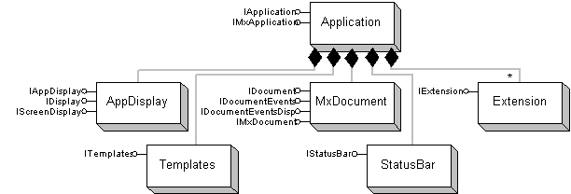

Slide 7
2.1.1 IApplication接口 (ESRI.ArcGIS.Framework)
IApplication定义了ArcGIS中所有桌面应用程序的一般功能。
This interface provides access to the Document object, the extensions, the StatusBar object, the Templates object, the currently selected tool, and the Visual Basic Editor.
  There are several methods that allow you to open, save, and print documents, lock and unlock the application from user customizations, display dialogs, and exit the application.

Slide 8
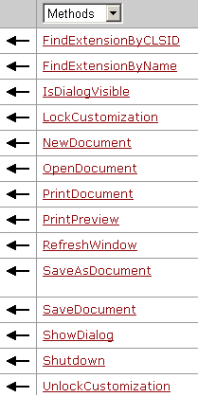
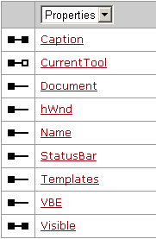
IApplication的属性、方法

Slide 9
在C#环境下，可用通过以下方法获得Application 对象:
Implementation | Reference | Method and parameter
Command, Tool, and ToolControl | IApplication | ICommand.OnCreate() hook parameter
MultiItem command | IApplication | IMultiItem.OnPopup() hook parameter
Extension | IApplication | IExtension.Startup() initializationData parameter
Dockable window | IApplication | IDockableWindowDef.OnCreate() hook parameter
IApplication m_application = hook as IApplication;

Slide 10
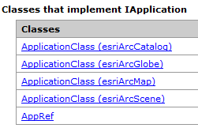
Classes that implement IApplication

Slide 11
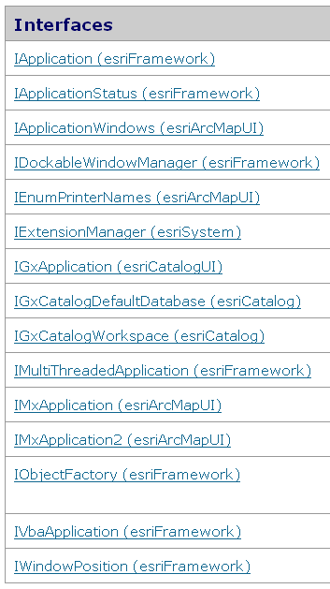
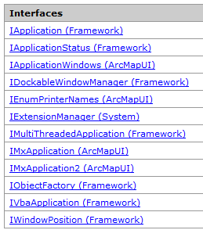
ApplicationClass (esriArcMap)
ArcObjects 10
ArcMap中嵌入Catalog

Slide 12
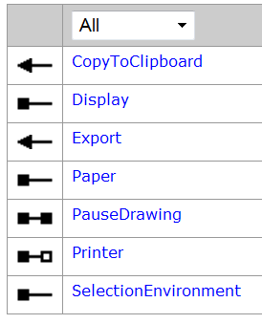
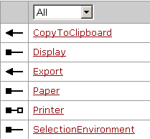
2.1.2 IMxApplication2接口 (ESRI.ArcGIS.ArcMapUI)
这是ArcMap程序特有的接口，用于管理SelectionEnvironment、Display、Paper和Printer等对象。
IMxApplication2
IMxApplication

Slide 13
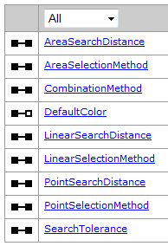
ISelectionEnvironment
Note: the IMxApplication interface has been superseded by IMxApplication2.
IMxApplication2.CopyToClipboard() 方法: Copies the current view to the clipboard.
IMxApplication2.SelectionEnvironment属性用于获取要素选择集的相关属性。

Slide 14
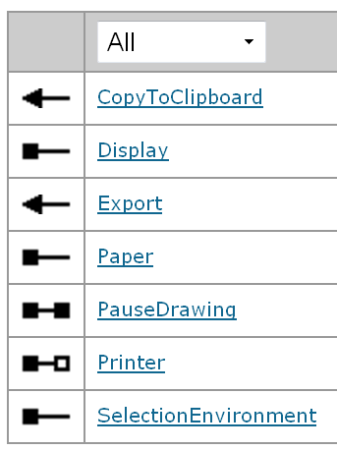
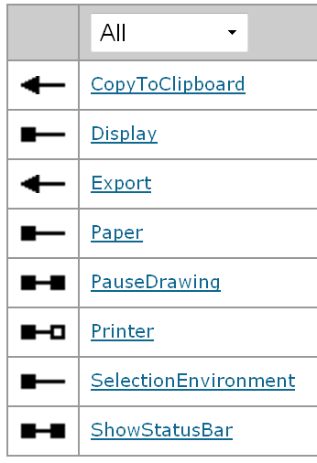
IMxApplication2
IMxApplication3
Pause display updates.
public bool PauseDrawing {get; set;}
public bool ShowStatusBar {get; set;}

Slide 15
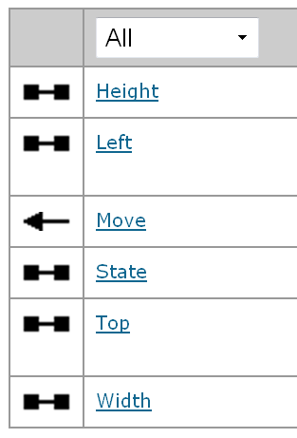
2.1.3 IWindowPosition接口 (ESRI.ArcGIS.Framework)
任何有可视化窗体的类都实现了IWindowPosition接口，如DockableWindow、CommandBar和各种Application类。
这个接口定义了窗体的尺寸和位置，如width和height确定了窗体的大小，而left和top规定了窗体的左上角距离屏幕的左上角之间的距离。
这个接口还定义了一个属性state，它用于确定程序窗口的形式，如esriWSNormal(正常模式)、esriWSMaximize(最大化模式)、esriWSMinimize(最小化模式)和esriWSFloating(浮动模式)四种。

Slide 16
2.2 Document对象
不同的ArcGIS桌面应用程序，使用的文档对象也不一样：
  ArcMap：MxDocument
  ArcCatalog：GxDocument
  ArcScene：SxDocument
应用程序一次只能有一个文档对象存在。
用户可以通过IApplication::Document来获取文档对象或者在VBA编程的框架中直接使用ThisDocument这个全局变量。

Slide 17
所有的文档对象都实现了IDocument接口 (ESRI.ArcGIS.Framework)，该接口定义了文档相关的以下6个只读属性：
  Accelerators ：文档中定义的加速键表；
  CommandBars：文档中定义的命令条的集合；
  ID：文档ID；
  Parent：打开这个文档的Application对象；
  Title ：文档标题；
  Type：文档类型；
  VBProject：文档的VB项目。
Constant | Value | Description
esriDocumentTypeNormal | 0 | The Normal template.
esriDocumentTypeTemplate | 1 | The base template.
esriDocumentTypeDocument | 2 | The current document.

Slide 18
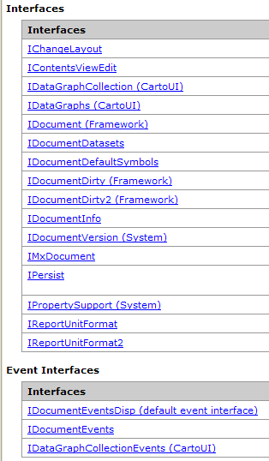
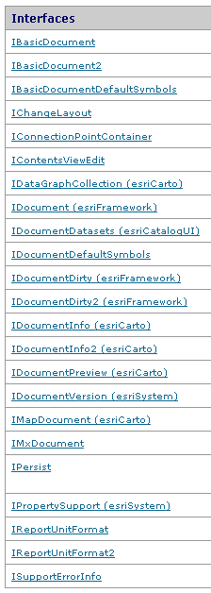

MxDocument (ESRI.ArcGIS.ArcMapUI)
ArcObjects 10

Slide 19
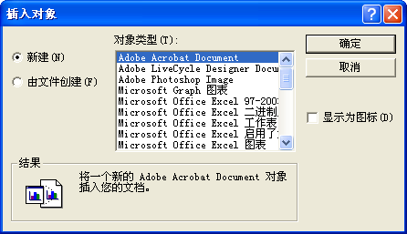
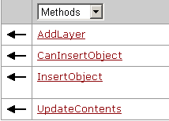
2.2.1 IMxDocument接口(ESRI.ArcGIS.ArcMapUI)
IMxDocument是MxDocument的默认接口，也是最主要的接口。该接口定义的方法如下：
Inserts an object into the document. Displays the insert object dialog.

Slide 20
public void UpdateContents ( );
  Refreshes the current view in the table of contents. UpdateContents is a shortcut - it calls Refresh on the current contents view (IContentsView.Refresh). Access to the current view is provided through IMxDocument.CurrentContentsView.

Slide 21
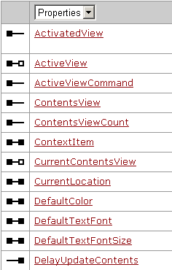
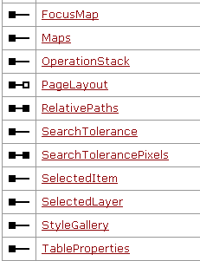
IMxDocument定义的属性

Slide 22
m_application = hook as IApplication;
IDocument document = m_application.Document;
IMxDocument mapDocument = document as IMxDocument;
如果通过某种途径先获得了文档对象mapDocument（IMxDocument） 则
  IDocument document = mapDocument as IDocument;
  IApplication m_application = document.Parent;

Slide 23
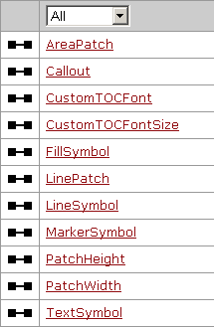
2.2.2 IDocumentDefaultSymbols接口
IDocumentDefaultSymbols接口是文档缺省符号设置接口，用于设置缺省颜色、符号。

Slide 24
2.2.3 IDocumentEvents接口
IDocumentEvents是MxDocument对象的一个外向事件接口，使用这个接口可以监听与地图文档对象有关的事件，如NewDocument事件，CloseDocument事件等。
IDocumentEvents和lDocumentEventsDisp非常相似，但是后者可以在VBA的编辑器中自动使用。使用VBA进行编程的时候，可以直接使用文档对象的一系列事件。IDocumentEventsDisp定义了诸如MapsChanged、CloseDocument等事件。

Slide 25
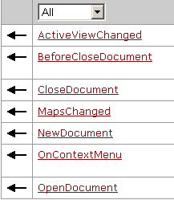
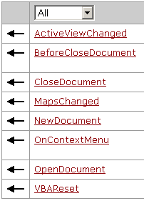

Slide 26
在C#环境下，可以通过以下步骤来监听文档事件：
1. Getting document object from application.
  using ESRI.ArcGIS.Framework;
  …
  IApplication app = hook as IApplication;
  IDocument appDocument = app.Document;

Slide 27
2. Declare an IDocumentEvents_Event variable.
  using ESRI.ArcGIS.Framework;
  using ESRI.ArcGIS.ArcMapUI;
  public class howToClass
  {
  private IDocumentEvents_Event m_docEvents = null;
  private void SetUpDocumentEvent( IDocument myDocument)
  {
  m_docEvents = myDocument as IDocumentEvents_Event;
  …
  }
  }

Slide 28
3. Implement the event handler method
  void OnNewDocument()
  {
  ……….
  }
4. Wiring NewDocument event to the handling method (C#).
  m_docEvents.NewDocument +=
  new IDocumentEvents_NewDocumentEventHandler (OnNewDocument);

Slide 29
  using ESRI.ArcGIS.Framework;
  using ESRI.ArcGIS.ArcMapUI;
  namespace ArcGISProject
  {
  public class howToClass
  { //Event member variable.
  private IDocumentEvents_Event m_docEvents = null;
  //Wiring.
  private void SetUpDocumentEvent(IDocument myDocument)
  { m_docEvents = myDocument as IDocumentEvents_Event; m_docEvents.NewDocument += new IDocumentEvents_NewDocumentEventHandler(OnNewDocument); }
  //Event handler method.
  void OnNewDocument() { …… }
  }
  }

Slide 30
Application Document 实例
  CommandInheritingBaseCommand （ZoomToSelectedLayer）
  DesktopAutomationCS

Slide 31
CommandInheritingBaseCommand （ZoomToSelectedLayer）
public override void OnCreate(object hook)
  { if (hook == null) return;
  m_application = hook as IApplication;
  if (hook is IMxApplication)
  base.m_enabled = true;
  else
  base.m_enabled = false;
  }

Slide 32
public override void OnClick()
  {
  IMxDocument mxDocument = GetMxDocument(m_application);
  ZoomToLayer(mxDocument);
  }
public IMxDocument GetMxDocument (IApplication application)
  {
  IMxDocument mxDocument = ((IMxDocument)(application.Document));
  return mxDocument;
  }

Slide 33
public void ZoomToLayer( IMxDocument mxDocument)
  {
  IMap map = mxDocument.FocusMap;
  IActiveView activeView = (IActiveView)map;
  IContentsView IContentsView = mxDocument.CurrentContentsView;
  ILayer layer = (ILayer)IContentsView.SelectedItem;
  if (!(layer is ILayer))
  { return; }
  activeView.Extent = layer.AreaOfInterest;
  activeView.Refresh();
  }

Slide 34
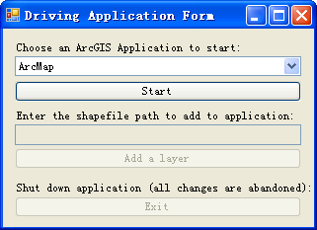
DesktopAutomationCS
IApplication m_application;
private void btnStartApp_Click(object sender, EventArgs e)
  {
  IDocument doc = null;
  switch (cboApps.SelectedItem.ToString())
  {
  case "ArcMap":
  doc = new MxDocumentClass();
  break;
  case "ArcScene":
  doc = new SxDocumentClass();
  break;
  case "ArcGlobe":
  doc = new GMxDocumentClass();
  break;
  }

Slide 35
  if (doc != null)
  {
  m_application = doc.Parent;
  m_application.Visible = true;
  }
  else
  { }
  }

Slide 36
2.3 Commands and Command bars
2.3.1 命令与命令条概述
  CommandBars、 CommandBar、 CommandItem
2.3.2 自定义命令和工具
2.3.3 自定义工具条和菜单
2.3.4 Creating multiple commands or tools in a single class(subtyped command)
2.3.5 动态菜单 (MultiItem)

Slide 37
2.3.1命令与命令条概述
ArcObjects提供了三类命令：
  单击命令（简单命令，Command）：仅实现ICommand接口。用户单击事件会导致对ICommand::OnClick方法的调用，并立即执行某种动作。
  工具（Tool）：实现了ICommand接口和ITool接口，工具的执行需要用户与地图显示进行交互。
  工具控件：实现了ICommand接口和IToolControl接口，如ArcMap中标准工具条上显示比例尺的控件，与下拉列表框类似。

Slide 38
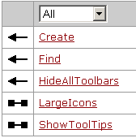
CommandBars (ESRI.ArcGIS.Framework)
CommandBars is a collection of all the toolbars available to a document.
  ICommandBars接口是CommandBars类的默认接口。
  Use IDocument::CommandBars to get a reference to the commandbars collection.

Slide 39
  public ICommandBar Create ( string Name, esriCmdBarType barType );
    esriCmdBarTypeToolbar
    esriCmdBarTypeMenu
    esriCmdBarTypeShortcutMenu
  public ICommandItem Find ( object identifier, bool noRecurse, bool noCreate );

Slide 40
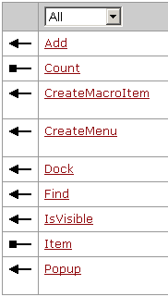
CommandBar
ArcObjects定义的CommandBar类型有三种：
  esriCmdBarTypeToolbar (工具条)、
  esdCmdBarTypeMenu (菜单)、
  esriCmdBarTypeShortcutMenu(快捷菜单)。
CommandBar类默认实现ICommandBar接口，它可以添加一个Command、Menu或者Macro到命令栏上。
  程序员可以通过Item属性得到commandbar中的每一个条目(Item)。
  使用Dock方法可以显示或者隐藏CommandBar，并且可以将它放在程序窗体的某个位置上或者处于浮动状态。

Slide 41
下面的代码是创建一个ToolBar：
public override void OnClick()
  {
  //得到CommandBars集合
  ICommandBars pCmdBars;
  IDocument doc = m_application.Document;
  pCmdBars = doc.CommandBars;
  //产生一个新的工具栏
  ICommandBar pnewBar = pCmdBars.Create("MyToolBar", esriCmdBarType.esriCmdBarTypeToolbar);

Slide 42
Constant | Value | Description
esriDockHide | 0 | Hides the toolbar.
esriDockShow | 1 | Shows the toolbar.
esriDockLeft | 2 | Docks the toolbar on the left side of the application.
esriDockRight | 4 | Docks the toolbar on the right side of the application.
esriDockTop | 8 | Docks the toolbar on the top of the application.
esriDockBottom | 16 | Docks the toolbar on the bottom of the application.
esriDockFloat | 32 | Floats the toolbar.
esriDockToggle | 64 | Toggles the toolbar visibility.
  //添加两个ArcMap已经存在的命令到新工具栏上
  object Missing = Type.Missing;
  UID pUid = new UIDClass();
  pUid.Value = "esriArcMapUI.AddDataCommand";
  pnewBar.Add(pUid, ref Missing);
  pUid = new UIDClass();
  pUid.Value = "esriArcMapUI.FullExtentCommand";
  pnewBar.Add(pUid, ref Missing);
  ////将产生的工具栏停靠在标准工具栏上
  pUid = new UIDClass();
  pUid.Value = "esriArcMapUI.StandardToolBar";
  ICommandBar pCmdBar = pCmdBars.Find(pUid, false, false) as ICommandBar;
  pnewBar.Dock(esriDockFlags.esriDockBottom, pCmdBar);
  }

Slide 43
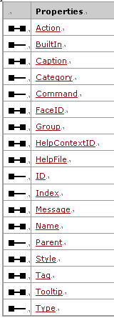
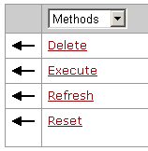
CommandItem
CommandItem代表出现在CommandBar上的任何对象，如一个Button、Menu和Tool等。ICommandItem接口是其默认接口，这个接口定义的方法可以获取或者设置CommandItem的属性，如设置标题、命令按钮图像、提示信息、显示样式和进行编组等。这个接口也定义了方法执行、删除、刷新和重置这些CommandItem。
使用ICommandBars::Find、ICommandBar::Find或ICommandBar::Item都可以得到某个特定CommandItem的引用。

Slide 44
下面代码是查找并执行一个命令：
public void FindAndExecuteCommand(IApplication application, string cmdName)
  {
  ICommandBars commandBars = application.Document.CommandBars;
  UID uid = new UIDClass();
  uid.Value = cmdName;
  ICommandItem commandItem = commandBars.Find(uid, false, false);
  if (commandItem != null) commandItem.Execute();
  }

Slide 45
2.3.2 自定义命令和工具
  自定义命令和工具的实现方式
  Extending ArcGIS Desktop with Custom Commands or Tools
  自定义命令工具开发实例

Slide 46
2.3.2.1 自定义命令和工具的实现方式
Three different ways to implement custom commands and tools:
  interface implementation（ICommand， ITool）
  base class inheritance（BaseCommand，BaseTool）
  ArcGIS Item templates（recommended）

Slide 47
Implementing interfaces
在自己的类代码中，实现ICommand（和） ITool的所有属性成员和相关的方法成员，包括属性和方法（根据情况可选）。
ArcGIS VS集成框架中的ArcGIS Class item template生成的类就是直接实现接口所有成员。

Slide 48
Inheriting ArcGIS base classes
为了简化自定义命令和工具的开发，ESRI提供了几个抽象基类，ESRI.ArcGIS.ADF.BaseClasses Namespace
  BaseCommand
  BaseTool
  BaseCommandBar
  BaseToolbar
  BaseMenu
  BaseCustomLayer
  BaseCustomGlobeLayer
  BaseDynamicLayer

Slide 49
BaseCommand 、BaseTool为ICommand和ITool每个成员提供了缺省的实现。开发者不用为每个成员提供实现代码，只需重写(override)自定义命令或工具所需要的成员。如ICommand::OnCreate，该成员在初始的类中必须被重写。
ArcGIS VS集成框架中的ArcGIS Base Command and Base Tool item templates就是通过继承基类来自定义命令和工具的。

Slide 50
BaseCommand和BaseTool有重载的构造函数，使得用户可以快速地通过构造函数参数设置命令和工具的许多属性，例如Name和Category。

Slide 51
重载的BaseCommand构造函数有下面的签名：
  public BaseCommand(
  System.Drawing.Bitmap bitmap,
  string caption,
  string category,
  int helpContextId,
  string helpFile,
  string message,
  string name,
  string toolTip
  );

Slide 52
重载的BaseTool构造函数有下面的签名:
  public BaseTool(
  System.Drawing.Bitmap bitmap,
  string caption,
  string category,
  System.Windows.Forms.Cursor cursor,
  int helpContextId,
  string helpFile,
  string message,
  string name,
  string toolTip
  );

Slide 53
当编写一个新类时，使用这些参数化的构造函数，例如，下面显示了称作PanTool的新类继承了BaseTool类。
  public PanTool() : base ( null,"Pan", "My Custom Tools", System.Windows.Forms.Cursors.Cross, 0, "","Pans the map.", "PanTool", "Pan" )
  {
  // ...
  }

Slide 54
作为使用参数化构造函数的备选方案，可以直接设置基类的成员。基类暴露其内部成员变量给继承类，每个属性一个，这样可以在继承类中直接访问它们。
  public PanTool()
  { base.m_cursor = System.Windows.Forms.Cursors.Cross;
  base.m_category = "My Custom Tools";
  base.m_caption = "Pan";
  base.m_message = "Pans the map.";
  base.m_name = "PanTool";
  base.m_toolTip = "Pan";
  }

Slide 55
Using ArcGIS item templates

Slide 56
2.3.2.2 Extending ArcGIS Desktop with Custom Commands or Tools
The Application object is the starting point for many ArcGIS Desktop customization. Commands and tools get a reference to the Application object from the ICommand.OnCreate method which is called by the framework when your command or tool is created.
  Although the hook parameter is a generic type of System.Object, the expected hook is a reference to the Application object which implements the ESRI.ArcGIS.Framework.IApplication interface.

Slide 57
Example 1
  Creating an application specific command/Tool
Example 2
  Create a generic command/Tool
Example 3
  Pass the hook object to dialogs or other .NET components.

Slide 58
Example 2. Create a generic command/Tool
按一般步骤创建一个命令或工具类；
注释或删除针对特定应用程序的代码；
Add code to register your class into all desktop application command categories using the Add ArcGIS Component Categories dialog. Check the following categories:
  ArcMap Commands
  ArcCatalog Commands
  ArcGlobe Commands
  ArcScene Commands

Slide 59
Example 3. Pass the hook object to dialogs or other .NET components.
情景：通过命令打开一窗体，然后在窗体中处理与应用程序相关的事情。

Slide 60
Create a desktop command using the ArcGIS Base Command template.
Add a form to your project, e.g. Form1，Add a button to the form
Add a write-only property to the form to accept the application object.
  using ESRI.ArcGIS.Framework;
  public partial class Form1 : Form
  { private IApplication m_application;
  …
  public IApplication ArcGISApplication
  { set { m_application = value; } } …
  }
Add code to the OnClick event handler of the form button to show a message box of the application.
  private void button1_Click(object sender, EventArgs e)
  { MessageBox.Show(m_application.Name); }

Slide 61
Back to the command file, add the following code to the OnClick method to initialize and hand over the Application object to the form.
  public sealed class Command1 : BaseCommand
  {
  private Form1 m_form;
  …
  public override void OnClick()
  {
    if (m_form == null || m_form.IsDisposed)
    {
    m_form = new Form1();
    m_form.ArcGISApplication = m_application;
    }
    if (!m_form.Visible) m_form.Show();
  }
  …
  }

Slide 62
2.3.2.3 自定义命令工具开发实例
清除Application的当前工具命令
  在GIS应用程序操作过程中，某个工具一旦使用，如果不使用下一个工具，它一直处于活动状态，这样总觉得不是很舒服。这个实例的功能就是清除Application上的当前活动工具。

Slide 63
private IApplication m_application;
public ClearCurrentToolCmd()
  {
  base.m_category = "Developer Samples"; //localizable text
  base.m_caption = "Clear Current Tool Command"; //localizable text
  base.m_message = "Clear Current Tool Command"; //localizable text
  base.m_toolTip = "Clear Current Tool Command"; //localizable text
  base.m_name = "ClearCurrentToolCmd";
  try
  {
  string bitmapResourceName = GetType().Name + ".bmp";
  base.m_bitmap = new Bitmap(GetType(), bitmapResourceName);
  }
  catch (Exception ex)
  { MessageBox.Show(""Invalid Bitmap"); }
  }

Slide 64
public override void OnCreate(object hook)
  {
  if (hook == null) return;
  m_application = hook as IApplication;
  //Disable if it is not ArcMap
  if (hook is IMxApplication)
  base.m_enabled = true;
  else
  base.m_enabled = false;
  }

Slide 65
public override void OnClick()
  {
  m_application.CurrentTool = null;
  }

Slide 66
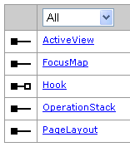
ZoomIn3X Command
  private IHookHelper m_hookHelper = null;
  private IActiveView m_activeView = null;
  private IEnvelope m_avExtent = null;
  public ZoomIn3XCMD()
  { base.m_category = "CustomSamples";
  base.m_caption = "ZoomIn3XCMD";
  base.m_message = " ZoomIn3XCMDM ";
  base.m_toolTip = " ZoomIn3XCMDT";
  base.m_name = " ZoomIn3XCMDN ";
  try { string bitmapResourceName = GetType().Name + ".bmp";
  base.m_bitmap = new Bitmap(GetType(), bitmapResourceName);
  } catch (Exception ex) { } }

Slide 67
public override void OnCreate(object hook)
  { if (hook == null) return;
  try { m_hookHelper = new HookHelperClass();
  m_hookHelper.Hook = hook;
  if (m_hookHelper.ActiveView == null) m_hookHelper = null;
  }
  catch { m_hookHelper = null; }
  if (m_hookHelper == null) base.m_enabled = false;
  else { base.m_enabled = true;
  m_activeView = m_hookHelper.ActiveView; }
  }

Slide 68
public override void OnClick()
  {
  if (m_activeView == null) return;
  m_avExtent = m_activeView.Extent;
  m_avExtent.Expand(1 / 3.0, 1 / 3.0, true);
  //m_avExtent.Expand(3.0, 3.0, true);
  m_activeView.Extent = m_avExtent;
  m_activeView.Refresh();
  }

Slide 69
ZoomIn3XTool
public sealed class ZoomIn3XTool : BaseTool
  { private IHookHelper m_hookHelper = null;
  private IActiveView m_activeView = null;
  private IEnvelope m_envelope = null;

Slide 70
public override void OnCreate(object hook)
  { try { m_hookHelper = new HookHelperClass();
  m_hookHelper.Hook = hook;
  if (m_hookHelper.ActiveView == null)
  { m_hookHelper = null; } }
  catch { m_hookHelper = null; }
  if (m_hookHelper == null) base.m_enabled = false;
  else base.m_enabled = true;
  m_activeView = m_hookHelper.ActiveView;
  }

Slide 71
public override void OnMouseDown(int Button, int Shift, int X, int Y)
  { IRubberBand pRubberBand = new RubberEnvelopeClass();
  m_envelope = pRubberBand.TrackNew(m_activeView.ScreenDisplay, null) as IEnvelope;
  m_envelope.Expand(1 / 3.0, 1 / 3.0, true);
  m_activeView.Extent = m_envelope;
  m_activeView.Refresh();
  }

Slide 72
2.3.3 自定义工具条和菜单
Command bars are containers of command items like buttons, tools, and submenus in an ArcGIS application.
  Toolbars, menus, and context menus are examples of command bars.

Slide 73
2.3.3.1 自定义工具条和菜单的实现方式
Three different ways to implement toolbars, menus, and context menus :
  interface implementation(IToolbarDef, IMenuDef , IMenuDef and IShortcutMenu )
  base class inheritance(BaseToolbar, BaseMenu)
  ArcGIS item templates(recommended)

Slide 74
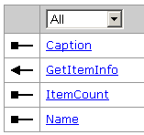
Implementing interfaces
To create a custom toolbar, implement IToolbarDef.
  You can use IToolbarControl.AddToolbarDef to insert your toolbar definition to a ToolbarControl in an ArcGIS Engine application.
To create a custom menu, implement IMenuDef.
To create a context menu, implement IMenuDef and IShortcutMenu.
    If you are creating a root menu (a menu that appears in the Menus command category in the Customize dialog box), implement both IMenuDef and IRootLevelMenu.
You can use IToolbarMenu to define menus and contexts menu in an ArcGIS Engine application.

Slide 75
Inheriting ArcGIS base classes
Instead of directly implementing the IToolbarDef or IMenuDef interface, you can use BaseToolbar and BaseMenu classes to define command items on a command bar in a script-like fashion.
public abstract class BaseToolbar : BaseCommandBar, IToolBarDef
public abstract class BaseMenu : BaseCommandBar, IMenuDef

Slide 76
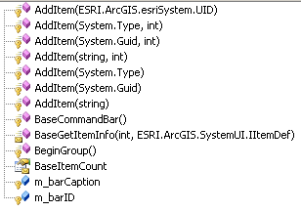
BaseCommandBar

Slide 77
Toolbar
public sealed class ArcFGISToolbar : BaseToolbar
  { public ArcFGISToolbar()
  { AddItem("ArcPXFGIS.ConvertCAD");
  AddItem("ArcPXFGIS.AddFeatureClass");
  BeginGroup();
  AddItem("esriArcMapUI.ZoomInTool");
  BeginGroup(); //Separator
  AddItem("{FBF8C3FB-0480-11D2-8D21-080009EE4E51}", 1); //undo command
  AddItem(new Guid("FBF8C3FB-0480-11D2-8D21-080009EE4E51"), 2); //redo command
  }
  public override string Caption
  { get { return “ArcFGISToolbar “; } }
  public override string Name
  { get { return " ArcFGISToolbar “; } }
  }

Slide 78
Menu
public sealed class ArcGISMenu1 : BaseMenu
  {
  public ArcGISMenu1()
  {
  AddItem("esriArcMapUI.ZoomInFixedCommand");
  BeginGroup(); //Separator
  AddItem("{FBF8C3FB-0480-11D2-8D21-080009EE4E51}", 1); //undo command
  AddItem(new Guid("FBF8C3FB-0480-11D2-8D21-080009EE4E51"), 2); //redo command
  }
  ……
  }

Slide 79
ContextMenu
public sealed class ArcGISContextMenu1 : BaseMenu, IShortcutMenu
  {
  public ArcGISContextMenu1()
  {
  AddItem("esriArcMapUI.ZoomInFixedCommand");
  BeginGroup(); //Separator
  AddItem("{FBF8C3FB-0480-11D2-8D21-080009EE4E51}", 1); //undo command
  AddItem(new Guid("FBF8C3FB-0480-11D2-8D21-080009EE4E51"), 2); //redo command
  }

Slide 80
2.3.4 Creating multiple commands or tools in a single class(subtyped command)
一般情况下，一个类中只有一个命令或一个工具，通过实现ICommandSubtype接口，可以在一个类中创建多个命令或工具。
ICommandSubtype
  GetCount：The number of commands defined with this CLSID.
  SetSubType：The subtype of the command.

Slide 81
Name | GUID (CLSID / ProgID) | Sub Type
File_New | {119591DB-0255-11D2-8D20-080009EE4E51} esriArcMapUI.MxFileMenuItem | 1
File_Open | 同上 | 2
File_Save | 同上 | 3
File_SaveAs | 同上 | 4
File_SaveCopyAs | 同上 | 12
File_PageSetup | 同上 | 5
File_PrintPreview | 同上 | 6
File_Print | 同上 | 7
File_Properties | 同上 | 8
File_Export | 同上 | 9
File_Exit | 同上 | 10

Slide 82
实现步骤：
创建普通的命令或工具类；
  public sealed class ZoomInCommands : BaseCommand
实现ICommandSubType 接口；
  public sealed class ZoomInCommands : BaseCommand, ICommandSubType
在 GetCount 方法中返回子命令数 ，如3.
实现SetSubType 方法，设置命令或工具的属性；
实现命令或工具的其它成员：
  命令：OnCreate ，OnClick
  工具： OnCreate ，鼠标事件

Slide 83
SubtypeCommandTool实例（ZoomInCommands.cs、PolyFeedbackTools.cs）
public sealed class ZoomInCommands : BaseCommand, ICommandSubType
  {
  private IApplication m_application;
  private int m_subtype;
  private ICommandItem m_xoomCommand;
  public ZoomInCommands()
  {
  //Set up common properties
  base.m_category = “Developer Samples";
  }

Slide 84
public int GetCount()
  { return 3; }
public void SetSubType (int SubType)
  { m_subtype = SubType;
  if (base.Bitmap == 0)
  { switch (m_subtype)
  { case 1: base.m_bitmap = Properties.Resources.ZoomOnce; break;
  case 2: base.m_bitmap = Properties.Resources.ZoomTwice; break;
  case 3: base.m_bitmap = Properties.Resources.ZoomThrice; break;
  } }
  base.m_caption = string.Format("Fixed zoom in x{0} (C#)", m_subtype.ToString());
  base.m_name = string.Format("CSNETSamples_SubTypeCommand{0}", m_subtype);
  base.m_message = string.Format("Executing fixed zoom in {0} time(s)", m_subtype.ToString());
  base.m_toolTip = string.Format("Fixed Zoom in x{0}", m_subtype);
  }

Slide 85
public override void OnCreate(object hook)
{ if (hook == null) return;
  m_application = hook as IApplication; base.m_enabled = false;
  if (m_application != null)
  { UID cmdUID = new UIDClass();
  switch (m_application.Name)
  { case "ArcMap": cmdUID.Value = "esriArcMapUI.ZoomInFixedCommand"; break;
  case "ArcGlobe": cmdUID.Value = "esriArcGlobe.GMxNarrowFOVCommand"; break;
  case "ArcScene": cmdUID.Value = "esriArcScene.SxNarrowFOVCommand"; break;
  }
  ICommandBars docBars = m_application.Document.CommandBars;
  m_xoomCommand = docBars.Find (cmdUID, false, false);
  base.m_enabled = m_xoomCommand != null;
  }
  }

Slide 86
public override void OnClick()
  {
  for (int i = 0; i < m_subtype; i++)
  m_xoomCommand.Execute();
  }

Slide 87
2.3.5 动态菜单 (MultiItem)
通常情况下，一个菜单上驻留的命令是固定的。当程序运行前菜单上的命令不能确定或菜单上的命令需要根据系统运行状态进行修改时，可以使用动态菜单。如很多应用程序File菜单下的最近使用过的文件菜单就是动态菜单。
一个类实现多个命令功能。

Slide 88
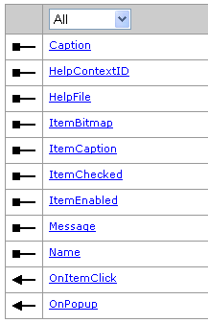
动态菜单实现IMultiItem接口，其行为就像多个相邻的菜单命令。需要创建自定义菜单来驻留MultiItem。
MultiItem与子命令或子工具不同，子命令或子工具上的条目数是固定的， MultiItem 是动态的。

Slide 89
IMultiItem
程序运行期间，应用程序框架通知动态菜单的宿主菜单何时显示，以及每一子项如何显示。
OnPopup 方法在其宿主菜单刚出现前被调用，并提供2个功能：
  提供hook参数
  返回动态菜单的项数
OnPopup 方法被调用后，应用程序框架为动态菜单的每一子项创建一个命令项，并为每一子项设置相关属性ItemBitmap, ItemCaption, ItemChecked, and ItemEnabled
MultiItem 显示后，用户可以选择某一项, 调用 OnItemClick 方法。
ZoomToLayerMultiItem 、RecentFilesCommands

Slide 90
ZoomToLayerMultiItem
public class ZoomToLayerMultiItem : IMultiItem
  {private IHookHelper m_hookHelper = null;
  private IActiveView m_activeView = null;
  private IMap m_map = null;
  public string Caption
  { get { return "Zoom to Layer MultiItem"; } }
  public string Name
  { get { return "ZoomToLayerMultiItem"; } }
  public int HelpContextID { get { return 0; } }
  public string HelpFile
  { get { return ""; } }
  public string Message
  { get { return "Zoom to Layer MultiItem"; } }

Slide 91
public int OnPopup(object hook)
  { if (hook == null) return 0;
  m_hookHelper = new HookHelperClass();
  m_hookHelper.Hook = hook;
  m_activeView = m_hookHelper.ActiveView;
  m_map = m_hookHelper.FocusMap;
  return m_map.LayerCount; }
public void OnItemClick(int index)
  { ILayer m_currentLayer = m_map.get_Layer(index);
  m_activeView.Extent = m_currentLayer.AreaOfInterest;
  m_activeView.Refresh();
  }

Slide 92
public string get_ItemCaption(int index)
  { ILayer m_currentLayer = m_map.get_Layer(index);
  return "Zoom To " + m_currentLayer.Name;}
public bool get_ItemEnabled(int index)
  { ILayer m_currentLayer = m_map.get_Layer(index);
  return m_currentLayer.Visible;}
public int get_ItemBitmap(int index)
  { return 0; //Not implemented. }
public bool get_ItemChecked(int index)
  { return false; }

Slide 93
RootMenuZoomToLayerMultiItem
public sealed class RootMenuZoomToLayerMultiItem : BaseMenu,IRootLevelMenu
  {
  public RootMenuZoomToLayerMultiItem()
  {
  AddItem("{bb0a9be6-0319-487a-a8c5-716378090388}");//ZoomToLayerMultiItem
  BeginGroup(); //Separator
  AddItem("esriArcMapUI.ZoomInFixedCommand");
  }

Slide 94
public override string Caption
  {
  get
  {
  return "Zoom to Layer MultiItem";
  }
  }
public override string Name
  {
  get
  {
  return "RootMenuZoomToLayerMultiItem";
  }
  }

Slide 95
2.4 应用程序扩展(Extension)
2.4.1 应用程序扩展概述
应用程序扩展（Extension）提供给开发者一个扩展ArcGIS核心功能的强大机制。一个Extension(扩展对象)可以给ArcGIS新建一个工具栏，也可以对应用程序发生的某些事件进行监听并做出响应，进行一些初始化工作。Extension是由Application对象直接管理的。
应用程序扩展有两种类型：标准扩展（Standard extension）和即时扩展（Just-in-time extension）。两种扩展实现的接口都是IExtension和IExtensionConfig（可选），任何实现了IExtensionConfig的扩展都将显示在扩展对话框中。它们的区别是启动的时机和注册的地方不同。

Slide 96
标准扩展
  任何被注册到应用程序的标准扩展，会自动被应用程序载入或者卸载。例如一个被添加到ESRI Mx Extensions Category的扩展对象会在ArcMap启动的时候自动启动，在ArcMap关闭的时候自动关闭，用户对此不需要进行任何的干预操作。
  标准扩展基本的启动顺序：
    用户启动应用程序；
    Application自动产生；
    文档对象创建；
    扩展对象被载入；
    打开、载入一个文档文件；
    程序启动完毕。

Slide 97
标准扩展注册的组件类目：
  ESRI Gx extensions (ArcCatalog)
  ESRI Mx extensions (ArcMap)
  ESRI Sx extensions (ArcScene)
  ESRI GMx extensions (ArcGlobe)

Slide 98
即时扩展
  为了提高应用程序在启动时候的性能， just-in-time (JIT) extension被设计为仅当有请求时才被载入应用程序，而不是在应用程序启动的时候载入，即当应用程序框架调用某个IExtension.Startup方法时，这个extension被载入。
  当应用程序第一次调用IApplication. FindExtensionByCLSID()方法查找某个及时扩展时，这个即时扩展被创建， IExtension.Startup()方法被调用。 IApplication.FindExtensionByName() 方法，对及时扩展不是总有效。

Slide 99
  即时扩展注册的组件类目：
    ESRI Gx JIT extensions (ArcCatalog)
    ESRI Mx JIT extensions (ArcMap)
    ESRI Sx JIT extensions (ArcScene)
    ESRI GMx JIT extensions (ArcGlobe)

Slide 100

2.4.2 创建应用程序扩展
标准应用程序扩展和即时应用程序扩展都实现了IExtension和IExtensionConfig（可选）接口,它们的区别是启动的时机和注册的地方不同。
ArcGIS Visual Studio集成框架为应用程序扩展的开发提供了两个项模板（Item Template）：Application Extension模板和Just In Time Extension模板，两个模板的实现都一样，只是注册方法的内容不一样，即注册的组件类目不同。
 |  | Description
 | Name | The name of the extension.
 | Shutdown | Shuts down the extension.
 | Startup | Starts up the extension with the given initialization data.
 |  | Description
 | Description | Detailed description of the extension.
 | ProductName | Name of the extension.
 | State | The state of the extension.

Slide 101
Samples
  DesktopExtensions
  OpenSaveLogExtension
  CustomizingAtStartup
  SelectionCOMSample

Slide 102
数据视图（Data View）中的Context Menu
功能：在数据视图的右键菜单中实现ZoomToLayer的MultiItem功能。
关键技术：
  使用Extension，扩展应用程序功能；
  使用IDocumentEvents的OnContextMenu事件。

Slide 103
public class ContextMenuExtension : IExtension
  { //声明两个类全局变量
  private IApplication m_application;
  private IDocumentEvents_Event m_docEvents;
  private void SetUpDocumentEvent (IDocument myDocument)
  {
  m_docEvents = myDocument as IDocumentEvents_Event;
  m_docEvents.OnContextMenu += new IDocumentEvents_OnContextMenuEventHandler(OnContextMenuProcessing);
  }

Slide 104
  public void OnContextMenuProcessing (int x, int y, out bool handled)
  {
  ICommandBar pContextMenu = m_application.Document.CommandBars.Create("My Context Menu", esriCmdBarType.esriCmdBarTypeShortcutMenu);
  object idx = Type.Missing;
  UID uid = new UIDClass();
  uid.Value = "ArcMapClassLibrary.ZoomToLayerMultiItem";
  pContextMenu.Add(uid, ref idx);
  pContextMenu.Popup(0, 0);
  handled = true;
  }

Slide 105
  #region "IExtension Implementations"
  public string Name
  { get { return "ContextMenuExtension"; } }
  public void Shutdown()
  {
  m_docEvents = null;
  m_application = null;
  }
  public void Startup(ref object initializationData)
  {
  m_application = initializationData as IApplication;
  SetUpDocumentEvent(m_application.Document);
  }
  #endregion

Slide 106
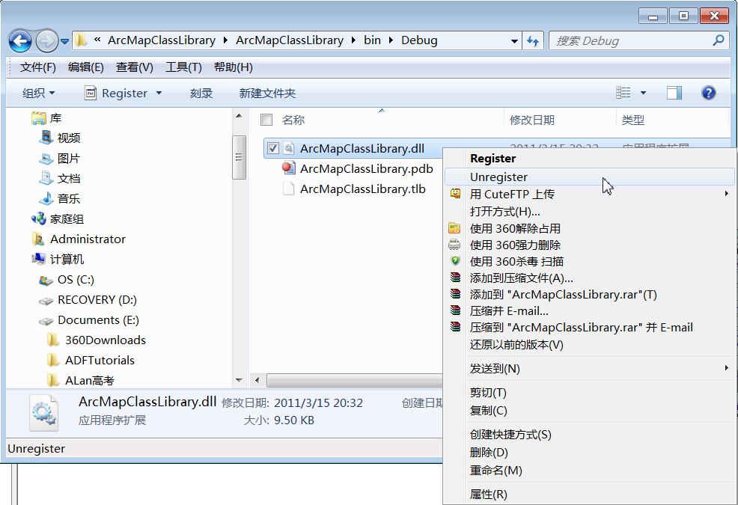
右键点击某组件,反注册

Slide 107
利用即时扩展实现内置的Data View Context Menu与MultiItem组合成新的上下文菜单
public class DataViewCTMJITExtension : IExtension, IExtensionConfig
  {
  private IApplication m_application;
  private esriExtensionState m_enableState;
  private IDocumentEvents_Event m_docEvents;
  #region IExtension Members
  ………………….
  #endregion

Slide 108
  public void OnContextMenuProcessing (int x, int y, out bool handled)
  {
  ICommandBar pContextMenu = m_application.Document.CommandBars.Create("ZoomToLayerMultiItem Context Menu", esriCmdBarType.esriCmdBarTypeShortcutMenu);
  IMxDocument mxDocument = m_application.Document as IMxDocument;
  IActiveView activeView = mxDocument.ActiveView;
  UID dataviewCTM = new UIDClass();
  activeView.GetContextMenu(0, 0,out dataviewCTM);
  object idx = Type.Missing;
  pContextMenu.Add(dataviewCTM,ref idx);
  UID uid = new UIDClass();
  uid.Value = " ArcMapClassLibrary.ZoomToLayerMultiItem ";
  pContextMenu.Add(uid, ref idx); pContextMenu.Popup(0, 0);
  handled = true;
  }

Slide 109
即时应用程序扩展不会在应用程序启动时自动加载，需要编写一个命令或其它方式调用。下面是用一个命令类来加载及时扩展的主要代码：
  public override void OnClick()
  {
  UID uid = new UIDClass();
  uid.Value = " ArcMapClassLibrary. DataViewCTMJITExtension ";
  m_application.FindExtensionByCLSID(uid); //加载即时扩展
  }

Slide 110
以上2个扩展不能同时实现?
因为标准扩展先接管了OnContextMenu事件,及时扩展没法再截取OnContextMenu事件.

Slide 111
2.4.3 查找应用程序扩展
2.4.3.1 使用 IApplication接口
获取应用程序扩展最直接的方法是是使用IApplication的FindExtensionByCLSID 或FindExtensionByName方法。
下面的代码展示了如何获取ArcMap Editor extension：
Find the Editor extension by the unique identifier object (UID):
  private void GetEditorExtension (IApplication application)
  { UID extensionID = new UIDClass();
  extensionID.Value = "esriEditor.Editor";
  IExtension editExtension = application.FindExtensionByCLSID(extensionID);
  }

Slide 112
Find the Editor extension by the name string. See the following:
  private void GetEditorExtensionByName (IApplication application)
  {
  IExtension editExtension = application.FindExtensionByName("ESRI Object Editor");
  }
与FindExtensionByCLSID方法不同的是： FindExtensionByName仅返回已载入的应用程序扩展。在ArcGIS 9.0之前, 这两个方法同样有效，因为所有扩展都在应用程序启动是被载入。从ArcGIS 9.0开始，引入了即时扩展。即时扩展，仅当FindExtensionByCLSID被调用的时候，才被载入应用程序。但使用FindExtensionByName方法不能载入即时扩展。

Slide 113
2.4.3.2 使用IExtensionManager或IJITExtensionManager接口
IExtensionManager管理已加载的应用程序扩展； IJITExtensionManager 管理即时应用程序扩展。
IExtensionManager.FindExtension works similar to FindExtensionByCLSID or FindExtensionByName on IApplication. Although it accepts either a UID or a name string, the same rule applies when loading JIT extensions. Loading by UID is guaranteed to return an extension if a valid identifier is provided.

Slide 114
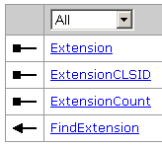
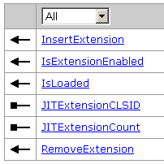
IExtensionManager
IJITExtensionManager

Slide 115
以下代码展示了如何列出ArcGIS桌面应用程序中注册的所有扩展：
  using ESRI.ArcGIS.esriSystem;
  using ESRI.ArcGIS.Framework;
  private void ExtensionList(IApplication application)
  {
    List<string> loadedExtensions = new List<string>();
    List<string> unloadedExtensions = new List<string>();
    //All extensions returned by extension manager have been loaded.
    IExtensionManager regularExtManager = application as IExtensionManager;
    for (int i = 0; i < regularExtManager.ExtensionCount; i++)
    {
    IExtension ext = regularExtManager.get_Extension(i);
    loadedExtensions.Add(ext.Name);
  }

Slide 116
  //Use IsLoaded to test if a JIT extension has already been loaded by request.
  IJITExtensionManager jitExtManager = application as IJITExtensionManager;
  for (int i = 0; i < jitExtManager.JITExtensionCount; i++)
  {
    UID extID = jitExtManager.get_JITExtensionCLSID(i);
    if (jitExtManager.IsLoaded(extID))
    {
    IExtension ext = application.FindExtensionByCLSID(extID);
    loadedExtensions.Add(ext.Name);
    }
    else //Just show the extension ID.
    {
    unloadedExtensions.Add(extID.Value.ToString());
    }
  }

Slide 117
  //Print extension information.
  System.Diagnostics.Trace..WriteLine("Extensions loaded in Application:");
  foreach (string ext in loadedExtensions)
  System.Diagnostics.Trace..WriteLine("\t" + ext);
  System.Diagnostics.Trace..WriteLine("CLSID of extensions haven't been loaded yet:");
  foreach (string extID in unloadedExtensions)
  System.Diagnostics.Trace..WriteLine("\t" + extID);
  }

Slide 118
2.4.3.3 获取可配置扩展的enable状态
实现了IExtensionConfig 接口的应用程序扩展是可配置的，Extension Manager 对话框中会显示它们的状态、产品名称和描述，也可以通过编程来访问这些属性。
  IExtensionManager extManager = application as IExtensionManager;
  for (int i = 0; i < extManager.ExtensionCount; i++)
  { IExtension ext = extManager.get_Extension(i);
  if (ext is IExtensionConfig)
  { IExtensionConfig extConfig = (IExtensionConfig)ext;
  if (extConfig.State == esriExtensionState.esriESEnabled) System.Diagnostics.Trace..WriteLine(extConfig.ProductName + " is enabled");
  } }

Slide 119
2.5 定制状态条(StatusBar)
状态条StatusBar是ArcGIS程序中用于显示程序操作状态的区域，当用户按下某个按钮时，它都会显示相应的提示信息。StatusBar是Application对象直接管理的，程序员可以通过StatusBar的定制改变状态栏的外观。

Slide 120
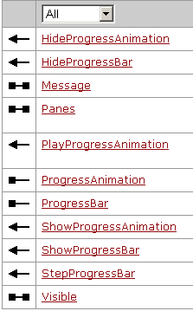
StatusBar类实现了IStatusBar接口，用于改变StatusBar的外观。状态栏一般被划分为几个面板(panel)，用户可以通过IStatusBar::Panes属性得到目前处于显示状态的任何一个面板对象。

Slide 121
esriStatusBarPanes的参数定义了让哪一个pane处于显示状态，ArcObjects中可以使用多个esriStatusBarPanes值来确定程序状态栏的样式。
  esriStatusBarPanes值为0代表MainPane
  esriStatusBarPanes值为1代表AnimationPane
  esriStatusBarPanes值为2代表PositionPane
  esriStatusBarPanes值为4代表PagePositionPane
通常程序使用的就是这四个pane，因而状态栏的esriStatusBarPanes缺省值是0+1+2+4=7。
如果希望出现所有的panes，可以设置这个值为255。

Slide 122
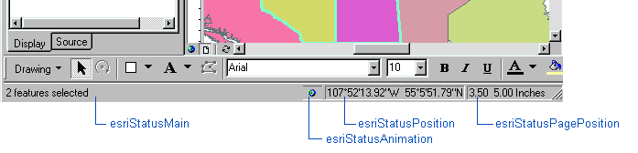
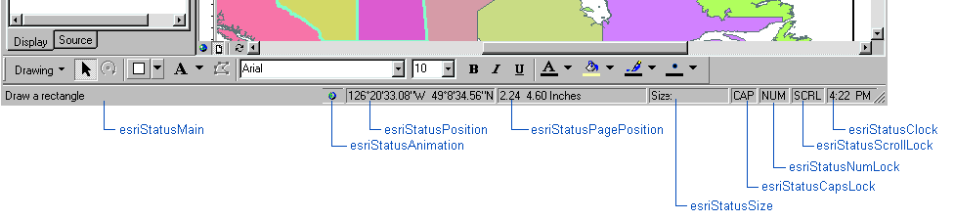

Slide 123
void StatusBar (IApplication pApp )
  {
  IStatusBar pStatusBar = pApp.StatusBar;
  pStatusBar.Panes = 255;
  }

Slide 124
Message属性：在状态条上显示提示字符信息。
IStatusBar接口的ProgressBar属性和HideProgressBar、ShowProgressBar和StepProgressBar都是用于控制状态条中的进度条对象。如果进度条会显示的话，它将出现在主状态条的面板上。进度条对象是StepProgressor，它实现了IStepProgressor接口。

Slide 125
显示进度条例子代码：
void ProgressBar( IApplication m_app)
  { IStatusBar pStatusBar; IStepProgressor pProgbar;
  pStatusBar = m_app.StatusBar;
  pProgbar = pStatusBar.ProgressBar;
  pProgbar.Position = 0;
  pStatusBar.ShowProgressBar("载入...", 0, 900000, 1, true);
  for (int i = 0; i < 900000; i++)
  { pStatusBar.StepProgressBar(); }
  pStatusBar.HideProgressBar();
  }

Slide 126
2.6 快捷键表
为了方便用户快速操作程序，很多软件都提供了快捷键的功能，它是实际键盘按键和命令之间的一种映射，当用户按下与某个命令相关联的按键时，这个命令就将被执行。
ArcMap使用AcceleratorTable对象来保存这种双向的映射关系，用户通过IDocument::Accelerators可以得到保存在一个文档文件中的这个快捷键表对象。
AcceleratorTable中保存着Accelerator(快捷键)的列表，可以通过IAcceleratorTable接口定义的属性和方法获得或者添加一个快捷键对象。
Accelerator类实现了IAccelerator接口，使用此接口可以设置一个快捷键的属性。

Slide 127
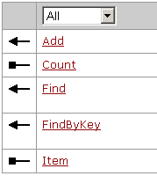
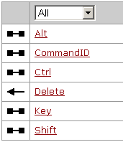
IAcceleratorTable
IAccelerator

Slide 128
public bool AssignShortcutKeyToCommand (IApplication m_app, System.Windows.Forms.Keys shortcutKey, string commandName)
  { System.Windows.Forms.Keys key = shortcutKey; // example: System.Windows.Forms.Keys.Z;
  bool keyCtrl = true; bool keyAlt = true; bool keyShift = false;
  IAcceleratorTable acceleratorTable = m_app.Document.Accelerators;
  IAccelerator accelerator = acceleratorTable.FindByKey((System.Int32)key, keyCtrl, keyAlt, keyShift);
  if (accelerator == null)
  { UID uid = new UIDClass();
  uid.Value = commandName; // example: esriArcMapUI. AddDataCommand";

Slide 129
  bool isAssigned = acceleratorTable.Add(uid, (System.Int32)key, keyCtrl, keyAlt, keyShift);
  return isAssigned;
  }
  return false;
  }
可以使用“Ctrl+D”的快捷键来执行“Add Data”的命令了。
  public bool Add ( object ID, int Key, bool bCtrl, bool bAlt, bool bShift );

Slide 130
2.7 定制窗口

Slide 131
2.7.1 属性页及属性窗口
(Property pages and property sheets )
2.7.1.1 概述
ArcGIS框架中有很多属性窗口，属性窗口驻留一系列相关的属性页。
属性页允许用户与对象交互来改变对象的一些属性，而不用写任何代码。

Slide 132
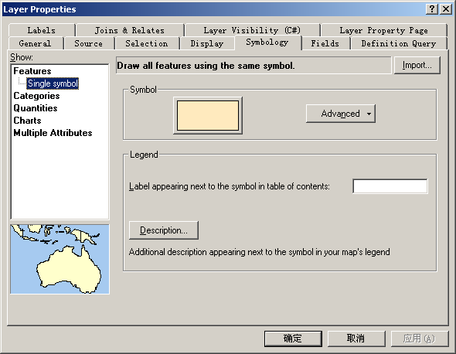

Slide 133
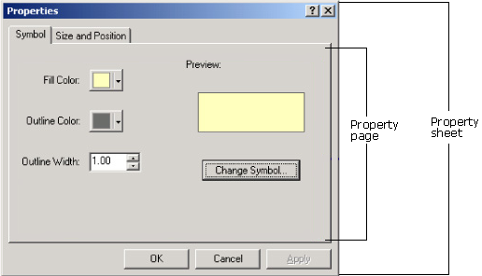
Element Property Page and Property Sheet

Slide 134
属性页注册在注册表中相关的组件类目中。
  ESRI Layer Property Pages
  ESRI Element Property Pages
  ……..
属性窗口相关的属性页，在程序运行过程中，通过读取注册表中相应的组件类目，动态生成。

Slide 135
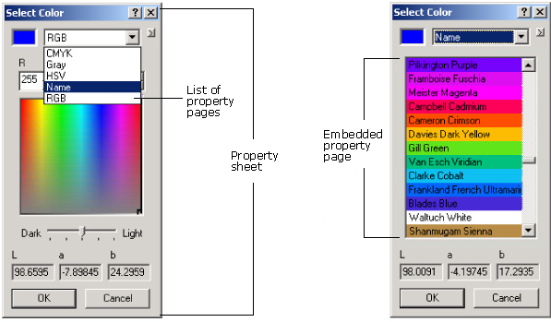
Embedded property pages
Embedded property pages are property pages that are designed to be contained inside other property pages or property sheets.

Slide 136
2.7.1.2 创建属性页及属性窗口
Property page interfaces
  IComPropertyPage
  IComPropertyPage2
  IComEmbeddedPropertyPage
  IPropertyPage and IPropertyPageContext, are generally used along with ATL implementation in VC++.

Slide 137
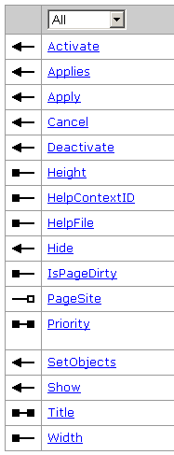
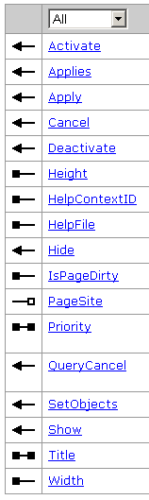
IComPropertyPage
Note: the IComPropertyPage interface has been superseded by IComPropertyPage2.
IComPropertyPage2

Slide 138
ArcGIS Desktop开发环境提供了用于开发属性页的项模板（Propeterty Page），利用这个模板可以生成两种类型的属性页：
  普通属性页(Generic Property Page)
  Layer属性页(Layer Property Page)
A property page is implemented in .NET by creating a user control that contains the user interface for the property page and implements the required property page interfaces.
public partial class LayerVisibilityPage : UserControl, IComPropertyPage

Slide 139
步骤：1、Create a property page class using the Property Page Item template
public partial class LayerVisibilityPage : UserControl, IComPropertyPage
  {
  private bool m_dirtyFlag = false;
  private string m_pageTitle;
  private IComPropertyPageSite m_pageSite = null;
  private ILayer m_targetLayer = null;
  private IActiveView m_activeView = null;
  public LayerVisibilityPage()
  {
  InitializeComponent();
  m_pageTitle = "Layer Visibility (C#)";
  }

Slide 140
2、Implement the Applies and SetObjects methods
bool IComPropertyPage.Applies(ESRI.ArcGIS.esriSystem.ISet objects)
  {
  if (objects == null || objects.Count == 0) return false;
  bool isEditable = false;
  objects.Reset();
  object testObject;
  while ((testObject = objects.Next()) != null)
  { if (testObject is ILayer)
  { isEditable = true; break; }
  }
  return isEditable;
  }

Slide 141
void IComPropertyPage.SetObjects(ESRI.ArcGIS.esriSystem.ISet objects)
  { if (objects == null || objects.Count == 0) return;
  m_activeView = null; m_targetLayer = null;
  objects.Reset(); object testObject;
  while ((testObject = objects.Next()) != null)
  { if (testObject is ILayer)
  m_targetLayer = testObject as ILayer;
  else if (testObject is IActiveView)
  m_activeView = testObject as IActiveView;
  //else
  //{
  //IApplication app = testObject as IApplication //Use if needed
  //}
  }
  }

Slide 142
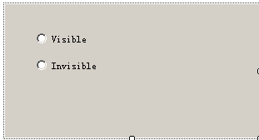
3、Add controls to the user control
  private System.Windows.Forms.RadioButton radioButtonShow;
  private System.Windows.Forms.RadioButton radioButtonHide;

Slide 143
4、Implement the Activate and Deactivate methods
int IComPropertyPage.Activate()
  { if (m_targetLayer.Visible) radioButtonShow.Checked = true;
  else radioButtonHide.Checked = true;
  SetPageDirty(false);
  return this.Handle.ToInt32();
  }
void IComPropertyPage.Deactivate()
  { m_targetLayer = null;
  m_activeView = null;
  this.Dispose(true);
  }

Slide 144
5、Implement the Apply and Cancel methods
void IComPropertyPage.Apply()
  { if (m_dirtyFlag)
  { m_targetLayer.Visible = radioButtonShow.Checked;
  if (m_activeView != null)
  { m_activeView.PartialRefresh( …….);
  m_activeView.ContentsChanged(); }
  SetPageDirty(false); } }
void IComPropertyPage.Cancel()
  { if (m_dirtyFlag)
  { radioButtonShow.Checked = m_targetLayer.Visible;
  SetPageDirty(false);
  }
  }

Slide 145
private void SetPageDirty(bool dirty)
  {
  if (m_dirtyFlag != dirty)
  {
  m_dirtyFlag = dirty;
  if (m_pageSite != null)
  m_pageSite.PageChanged();
  }
  }

Slide 146
6、Implement other interface members
The item template has already added code to Title, Height, and Width properties.
IComPropertyPageSite IComPropertyPage.PageSite
  {
  set
  {
  m_pageSite = value;
  }
  }
bool IComPropertyPage.IsPageDirty
  {
  get { return m_dirtyFlag; }
  }

Slide 147
If necessary, implement IComPropertyPage2, IComEmbeddedPropertyPage, or any specialist property page interfaces such as IRendererPropertyPage and ISymbolPropertyPage:

Slide 148
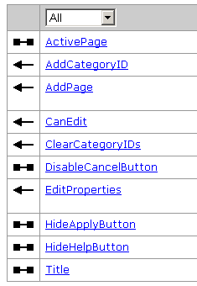
在属性窗口中使用属性页
自动使用（属性页已自动注册到了适当的组件类目中）
通过命令使用
Use IComPropertySheet and ComPropertyPageClass

Slide 149
  private IApplication m_application;
  private string m_layerCategoryID = string.Empty;
public override void OnCreate(object hook)
  {
  if (hook == null) return;
  m_application = hook as IApplication;
  if (m_application != null)
  m_layerCategoryID = "{1476c782-6f57-11d2-a2c6-080009b6f22b}";
  }

Slide 150
public override void OnClick()
  {
  IComPropertySheet myPropertySheet = new ComPropertySheetClass();
  myPropertySheet.Title = "Simplified Layer Properties (C#)";
  myPropertySheet.HideHelpButton = true;
  //Add by component category - all pages registered in the layer property page
  UID layerPropertyID = new UIDClass();
  layerPropertyID.Value = m_layerCategoryID;
  myPropertySheet.AddCategoryID(layerPropertyID);
  //Or add page by page - but have to call Applies yourself
  //myPropertySheet.ClearCategoryIDs();
  //myPropertySheet.AddCategoryID(new UIDClass()); //a dummy empty UID
  //myPropertySheet.AddPage(new LayerVisibilityPage()); //my custom page
  //myPropertySheet.AddPage(new LayerDrawingPropertyPageClass());
  //Pass in layer, active view and the application

Slide 151
  ISet propertyObjects = new SetClass();
  IBasicDocument basicDocument = m_application.Document as IBasicDocument;
  propertyObjects.Add(basicDocument.ActiveView);
  propertyObjects.Add(basicDocument.SelectedLayer);
  propertyObjects.Add(m_application); //optional?
  //Show the property sheet
  if (myPropertySheet.CanEdit(propertyObjects))
  myPropertySheet.EditProperties(propertyObjects, m_application.hWnd);
  }

Slide 152
2.7.2 定制可停靠窗口(DockableWindow)
DockableWindow是一种能够处于浮动状态或者停靠在主程序上的窗体，起到显示数据的辅助作用，它是一种无模式(modeless)的窗体。如ArcMap的TOC对象和ArcCatalog的TreeView都是一种DockableWindow对象。开发者可以使用IDockableWindowManager::GetDockableWindow方法，通过传入浮动窗体的UID属性来得到一个DockableWindow对象。
IDockableWindow接口能查询一个浮动窗体的属性，如Caption、ID和名字等。它也有方法返回这个窗体以及是否可见或者停靠在哪一个区域。
DockableWindow类也实现了IWindowPosition接口用于改变浮动窗体在屏幕上的位置。注意，使用这个接口的任何属性和方法前，要保证它必须处于浮动状态。

Slide 153
程序员也可以在程序中新建自己的DockableWindow对象，使用IDockableWindowDef接口中的方法可以完成这个任务。这个接口能够让程序员设置属性，如标题和名字；ChildHWND属性用于确定哪一个对象将放在这个浮动窗体上，而OnCreate方法可以让窗体进行初始化。当这个窗体被卸载的时候，可以调用OnDestroy方法。
需要注意的是，使用IDockableWindowDef创建DockableWindow的时候仅仅是定义了一个类，而并非实际存在这个对象，只有当将这个类注册到DockableWindow Component Categories中的时候，程序才能使用定义的窗体去建立一个实际的浮动窗体对象。

Slide 154
用DockableWindow显示各图层选择的要素数
创建DockableWindow
public partial class SelectionCountDockWin : UserControl, IDockableWindowDef
  {
  private IApplication m_app;
  private IMxDocument m_mxDoc;
  private MxDocument m_mxDocument;
  private IMap m_map;
  private IPageLayout m_pageLayout;
  private IDocumentEvents_NewDocumentEventHandler DNewDocE;
  private IDocumentEvents_OpenDocumentEventHandler DOpenDocE;
  private IDocumentEvents_MapsChangedEventHandler DMapsChangedE;
  private IActiveViewEvents_SelectionChangedEventHandler DSelChangedE;
  private IActiveViewEvents_FocusMapChangedEventHandler DFocusMapChangedE;
SelectionCOMSample

Slide 155
void IDockableWindowDef.OnCreate(object hook)
  {
  m_app = hook as IApplication;
  m_mxDoc = m_app.Document as IMxDocument;
  m_map = m_mxDoc.FocusMap as IMap;
  m_pageLayout = m_mxDoc.PageLayout as IPageLayout;
  SetupEvents();
  OnSelectionChanged();
  }

Slide 156
private void SetupEvents()
  {
  DNewDocE = new IDocumentEvents_NewDocumentEventHandler(OnNewOpenDoc);
  ((IDocumentEvents_Event)m_mxDoc).NewDocument += DNewDocE;
  DOpenDocE = new IDocumentEvents_OpenDocumentEventHandler(OnNewOpenDoc);
  ((IDocumentEvents_Event)m_mxDoc).OpenDocument += DOpenDocE;
  DMapsChangedE = new IDocumentEvents_MapsChangedEventHandler(OnMapsChanged);
  ((IDocumentEvents_Event)m_mxDoc).MapsChanged += DMapsChangedE;
  DSelChangedE = new IActiveViewEvents_SelectionChangedEventHandler(OnSelectionChanged);
  ((IActiveViewEvents_Event)m_map).SelectionChanged += DSelChangedE;
  DFocusMapChangedE = new IActiveViewEvents_FocusMapChangedEventHandler(OnMapsChanged);
  ((IActiveViewEvents_Event)m_pageLayout).FocusMapChanged += DFocusMapChangedE;
  }

Slide 157
private void OnSelectionChanged()
  { IMap focusMap; IFeatureLayer featLayer;
  IFeatureSelection featSel; focusMap = m_map;
  this.listBox1.Items.Clear();
  for (int i = 0; i <= focusMap.LayerCount - 1; i++)
  { if (focusMap.get_Layer(i) is IFeatureSelection)
  { featLayer = focusMap.get_Layer(i) as IFeatureLayer;
  featSel = featLayer as IFeatureSelection;
  this.listBox1.Items.Add(featLayer.Name + ": " + featSel.SelectionSet.Count);
  }
  } }

Slide 158
使用DockableWindow（CMD）
  private IApplication m_app;
  private IDockableWindow m_dockWin;
public override void OnCreate(object hook)
  { if (hook == null) return;
  if (hook is IMxApplication)
  { m_app = hook as IApplication;
  IDockableWindowManager dockWinMgr = m_app as IDockableWindowManager;
  UID u = new UID();
  u.Value = "{a8bfd199-e06f-47ef-9f03-4d3eaef856cd}";
  m_dockWin = dockWinMgr.GetDockableWindow(u);
  }
  else base.m_enabled = false;
  }

Slide 159
public override void OnClick()
  {
  m_dockWin.Show(!m_dockWin.IsVisible());
  }
public override bool Checked
  {
  get
  {
  return m_dockWin.IsVisible ();
  }
  }

